Slide 1
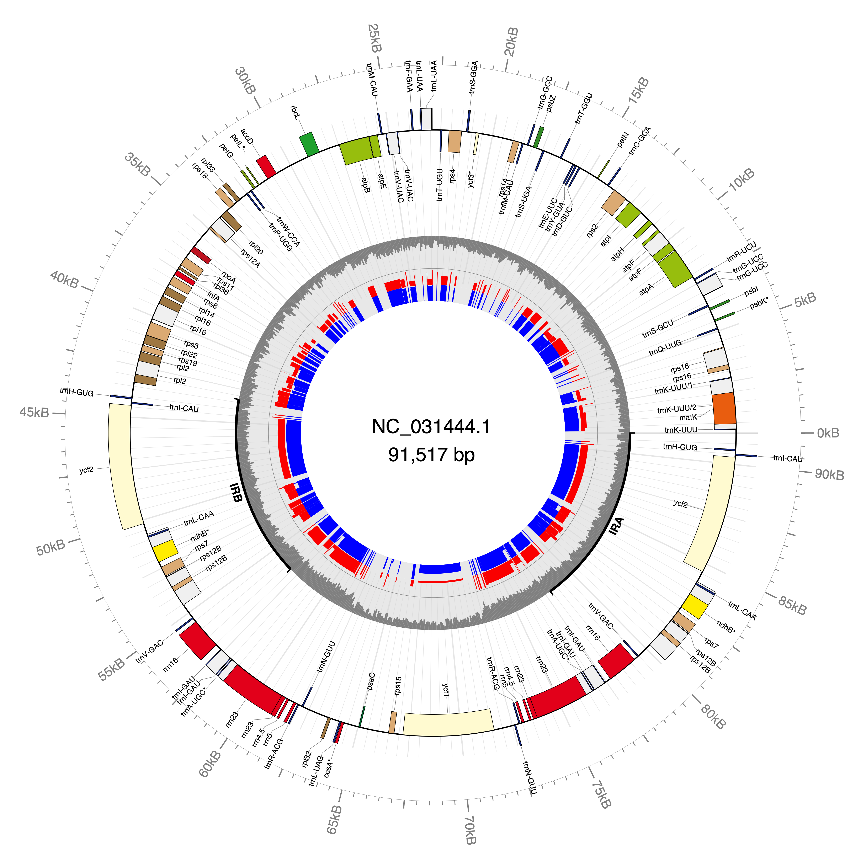

Genome annotation
Ian Small
SCIE4002
DNA (and RNA) sequences alone are difficult to interpret. They become much more useful and understandable when annotated to reveal the functional units they contain.
>NC_031444.1
TTTATATACTATAAATTAAAATTAAAACATAAAATGTAAGACTTGTTATTCAACAGTAATGACTTATATA
TTCGTGTCAACAAATCTCAATAACTATATTAAATATATTCAAGCGGATTACAAAAAGAAAATATGGATCA
TAGAATTTATAATTTTAATATGACGGTGGGTTGCCCGGGATTCGAACCCGGAACTAATCGGATGGAGTAG
ATAATTTGTTTGTTATGTTAGTTAAATAAAGAAAAATCTCTCCCCAAGCCGTGCTTGCAGTTTTCACTGC
ACACGGCTTTCCCTATGTATACATAATTTTCCGTTCTTATAATAAATAAATAAACTTTATTTAAATCAAT
TGAATATTCAATTGATTTAACCCTTATTACATATTACATACTATATAAACATTTCAGAATAGTATAAATC
CATGAATAAATTTTATTTTCAAAATTTCATTATTTGTAATAGGCCATAATAAAAACAATATCCAAATACC
AAATTCGACTTCTATATACTTCCTGTAAACTGGAAGAAGCTTTTGGTAATGTCAAAAAAAGAACGTTTTC
TTTCGCCATAAGAAATTCTTCTAATAATTCCGAGTCAAATCTTTTCAAAAAAGTACGTAGAGTACTTTTG
TGTTTCCGAGCCAAAGTTTTAGCACAAGAAAGTTGAAGTATATACTTTATTCGATACAAACTTTTTTTTT
TTGAAGATCCACTATGATAATGATAAAAATTTCTGCATATAGACCCAAATCGATCAATAATATTAGAATC
TGATAAATTAGCCCAAACTGACTTACTAATGGGATGCCCTAATACGTTACAAAATTTCGCTTTAGCCAAT
GAAGCAATCAAAGGAATAATTGGAACAAAGGTATCGACTTTATTAATAGCATTATTTATTAGAAATGAAT
TTTCTAGGATTTTACTCCGTATTACTGAAGAGTTCATTCGCAAGTTTAAAAGATAACCTAAAAATTCAAA
GGACTGATTGGATAATTGGTTTATATAAATCCTTCTTGTATAAAACCACAGAGAAAAATGCCATTGCCAA
AAAGTAATCAAGTACAATTTCCATTTATTCATGAAAAAGGGCGTCCCTTTTGAAGCCAGAATGGATTTTC
TTTGATACCTAATATAATGAAAGCAAGGTTCCTTGAACACCCATTGGTTCACTTGAAAATCCTTAACCTT
TACAAAAACATTCACAAGATATTTTATTTTTCCATAGAAATATATTCGTTCAAGAAGAACTCCAAAGGAT
ATTGATCGTAAATGATAAGATTGGTTACGTAGAAAGACGAAAATATATTCGTATTCACATACATGAGAAT
TATATAAGAATAAGAATAATCTTTGATTACTTTTTGCAAAAAAAGAACTGGCTTTCTTTGGAGCAATAAA
ACTATTCCCATTTTTGTTGATAAAGAATCGTAATAAATGCAAAGAAGAGGCATCTTTTATCCAATATCGA
AGAGTTTGGACCAATATTTCCGCATGGACCAAGTGGGGTATTTGTATATCTAATAGTAAATTTAAATGTG
AAAGACTATCCTCTAAAAATGGAAATATTGAATGAATTGATCGTAAATTCTGCGATTTTACTATCTTTTT
ATTTTTCTCTTCTATACAAGATATTAATCGTAGAGAAAATGGAATTTCCACAATAAAAGCAAGCCCCTCT
GATATGATTTCAGAATACCAACTTTTGGTGCGCATCAAAAATGGAGTTTGATTAGAAGCATTAGAAGAAA
TAAAAAAATGATTCTGTTGATACATTCGAGTAATTAATCGTTTCACAATCAGTAAACTGGATTTCTTGTC
ATAACCTAAACTTTCCGAATAAATAAAAATAGATCTACCGAAACCACGATCATGAGCAAATGAATAAATA
TACTCCTGAAAAATAAGTGGATATAGGAAACGGTGTTGTTGAGATCTTTCTAGCTGTAAATATTTTTGGA
TTTCCTCCATTTGAAATTTAAATCAAAAGTAGAAAATTTTGTGGGTTATCAAATGATACATAGTACGATA
TAGTCAAAACAAACTATTCTAGTCAGAATAGATACCTCGTAGACAGGTATCAACAGACTCTCTACCCTCC
CCTTATTCCTATTCATTTATTTCATTCGTCTATGTTATAGGATAAACAAGATGTTTAGAAATCTTTTATT
TTATAAACCTAATCGCTCTTTTGATTTAGGAAAAACTTTTTTAATCAATATACTGCTTCTTTTACACACG
CATTTTCATTTCATACTAGAGAATGTTAATAGTTAGGATTCATTAAAAAATATAGATCCACTCGTGGGGG
AGAAGTCCTTCCCGTATCAGGCACTAATCTATTTTTAACGTCTAATTAGATCGGTAAATTATTCAAATTA
AGAATAGAAGCTGGTTGCTTTTTATTTCTAATAATGAATTGAAGCCCTGGGGCCTTATCCATCTATTCAT
CCGACCCAAACTTTATTTTGTTCCGTTGCAAGAATTCAAACAAGATTTTATACTAATCCTAGAGGAATCA
AATATCCTCAAAACTCTCCATTGATACGACATGCTATTTTTTCCATTTATTCCCTTTTACGGATCAGTCG
TGGTTTTACAAACTAATGGTATGGACGAATTCTTCACTTCATCAAATGTGTAAAAGATTATAGTCGCACT
TAAAAGCCGAGTACTCTACCGTTGAGTTAGCAACCCGAATAAAATAGAGATTAAACAAAACTTCAAATAA
AAACTAAAGGATGTATAGATACAATCGATCAAAATAAATTAAATTTAAACAAAGAGAAAGAAGATTCGAC
GAGCTAATAAAATAAAATGCTAAGCTAATAAATCTACAAAAACAGGTTTTCTAAAAGATTCGAAACATCG
TTACAATGAAAACTACATACATAATTTAAGGAAATGTCTAAATTTGATATTTATAAGATCAATATATACT
AATATTTTGTCGTTATAATCCATCGAATTCAACATAAACAATGATAAATAAATATGAATACAGCAAAAAA
CAAAAGGAGAGGGGGGATCAAAAAAAAAGTATAGAAAAATTATATAAAATTATATACAAGTTGCTACCCC
TCCTTGGTATTTCTTTAATTGAATTTTATTTGATTAAACGGAAGTTTCTTAAAAACTTCTATTTTCTTTA
AAAGATTCTGAACAGTTCCTGTGGGTTGAGCACCTTTTTCAAGAAAATATAGAATAATAGGAATATTTAA
ATAAGTTTGATTTTTCATTGGATCATAAAAACCTACTCTTCTAAGATCTTTTCCTTCTCTTCGAGATCGA
ACATCAATTGCAATGATTCGATAGATGGCTCATTGGGATAGATAAACAATACCCCCCCCTAGAACCGTAT
AGGAAGTTTTCTCCTCATACGGCTCAAGAAAAATTTTTTGATTCGAAATTTTGTCTATATATTAAATTAT

Slide 2
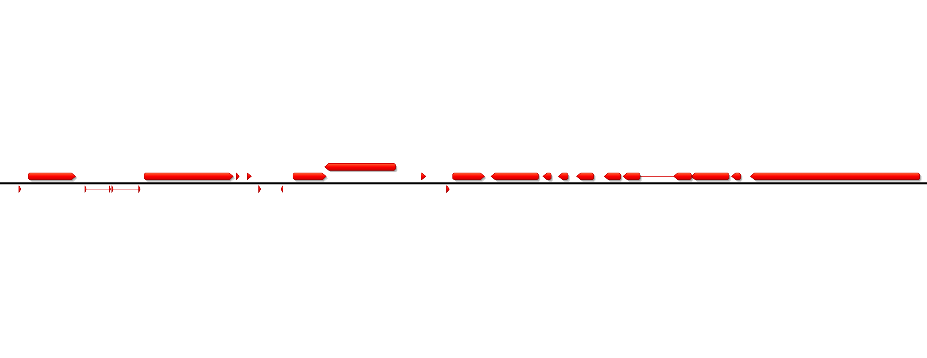
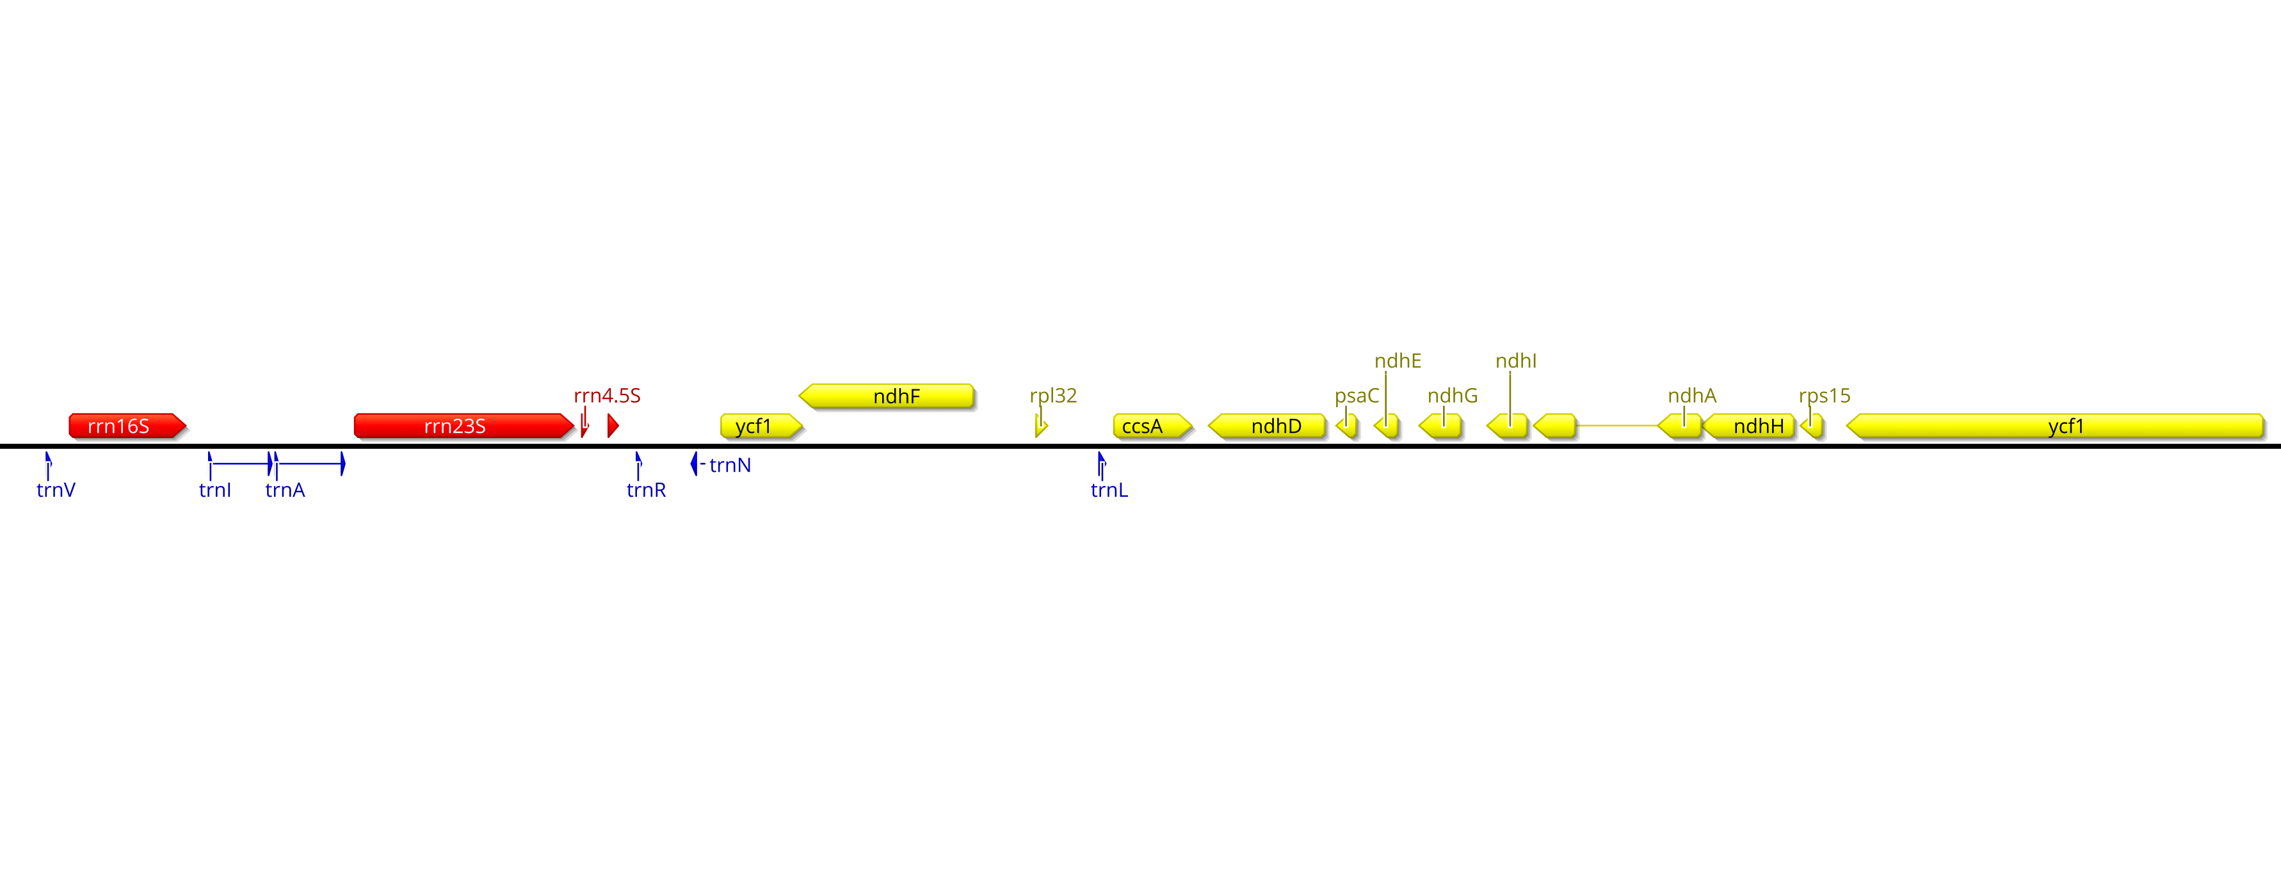
Structural annotation labels potential structural units within the sequence (exons, introns, open reading frames etc.) without trying to attach detailed functions to them
Structural annotation uses information in the sequence data itself (especially RNA-seq data if it’s available). It does not necessarily require comparison to sequences from other organisms (although this helps!)
Functional annotation attempts to ascribe specific functions to each structural unit
Functional annotation uses information from sequence comparisons. It absolutely requires comparison to known functional elements from other organisms.
Structural and functional annotation can be done separately using different software tools, but most effective annotation pipelines do both in parallel

Slide 3
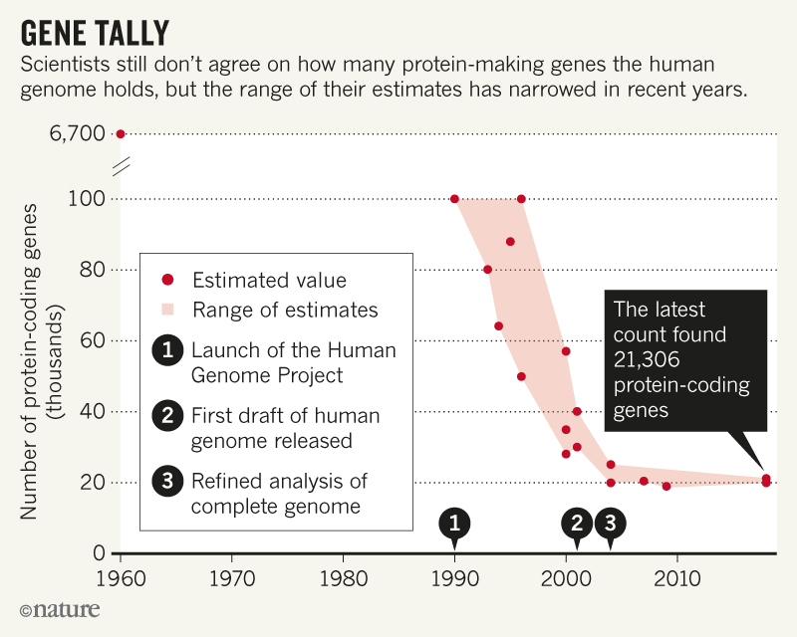
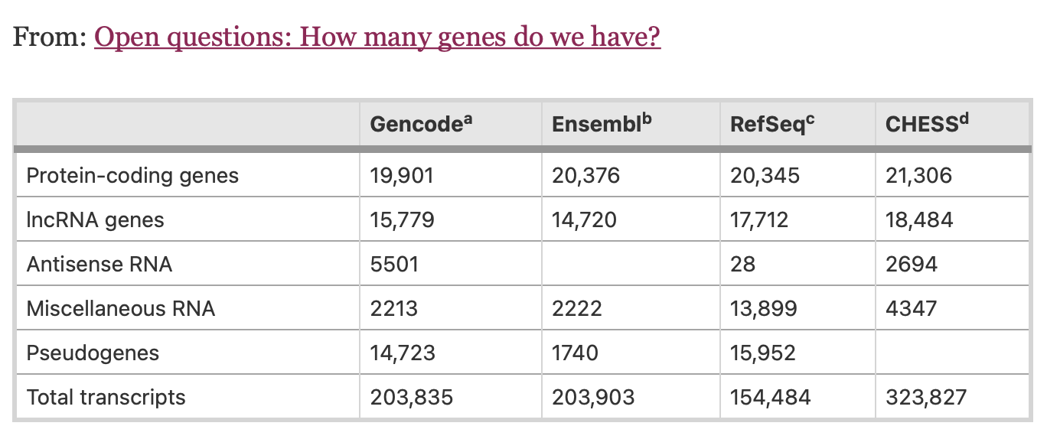
Uncertainties and errors in annotations
https://bmcbiol.biomedcentral.com/articles/10.1186/s12915-018-0564-x/tables/1
https://www.nature.com/articles/d41586-018-05462-w

Slide 4
Ranking annotation sets by discordance with PPRfinder models
IWGSC v1.0 annotations
rye v1 annotations

Slide 5
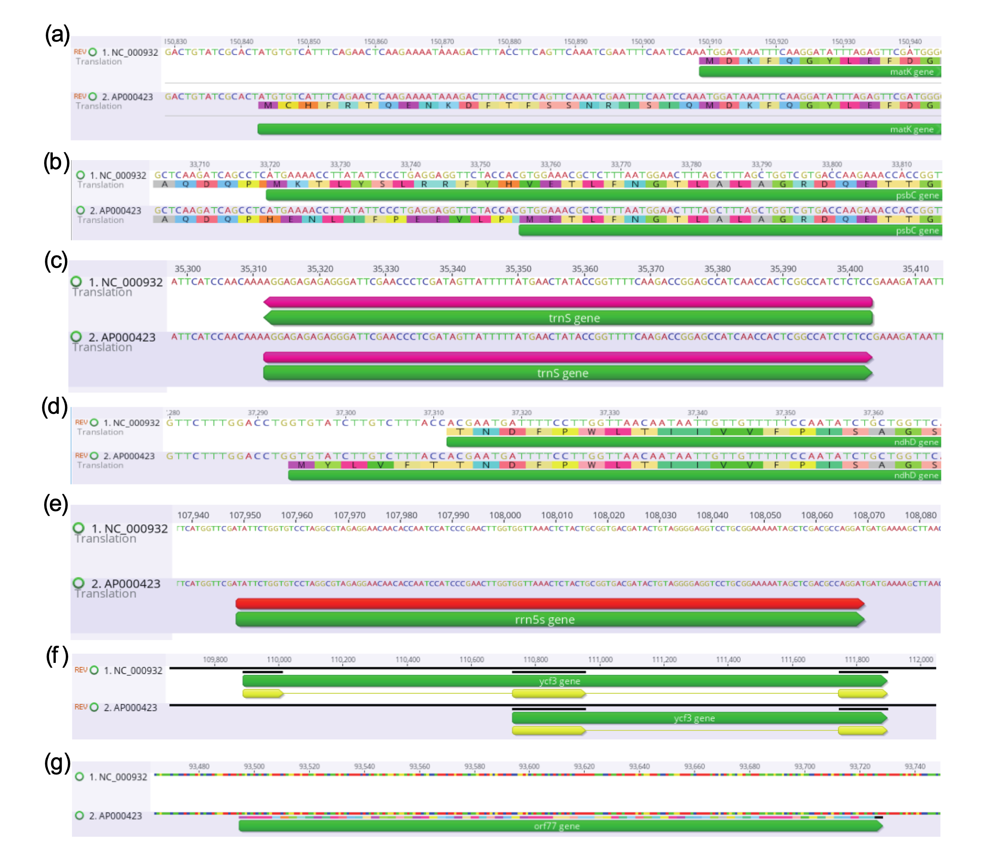
Examples of incorrect annotations of the Arabidopsis thaliana plastome
incorrect start codon
(matK)
incorrect start codon
(psbC)
incorrect strand
(trnS)
incorrect start codon
(ndhD)
missing gene
(rrn5)
missing exon
(ycf3)
spurious gene
(orf77)

Slide 6
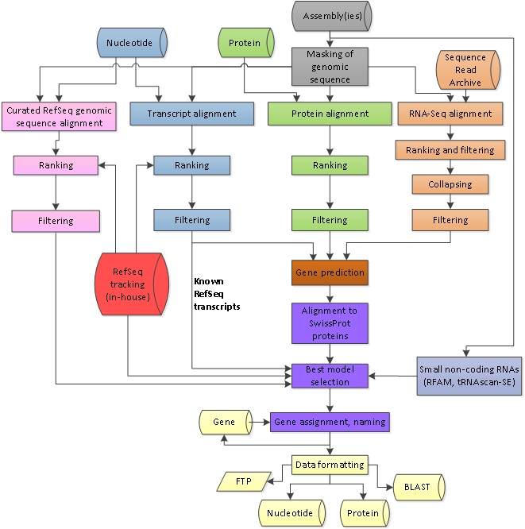
The NCBI Eukaryotic Genome Annotation Pipeline
https://www.ncbi.nlm.nih.gov/genome/annotation_euk/process/

Slide 7
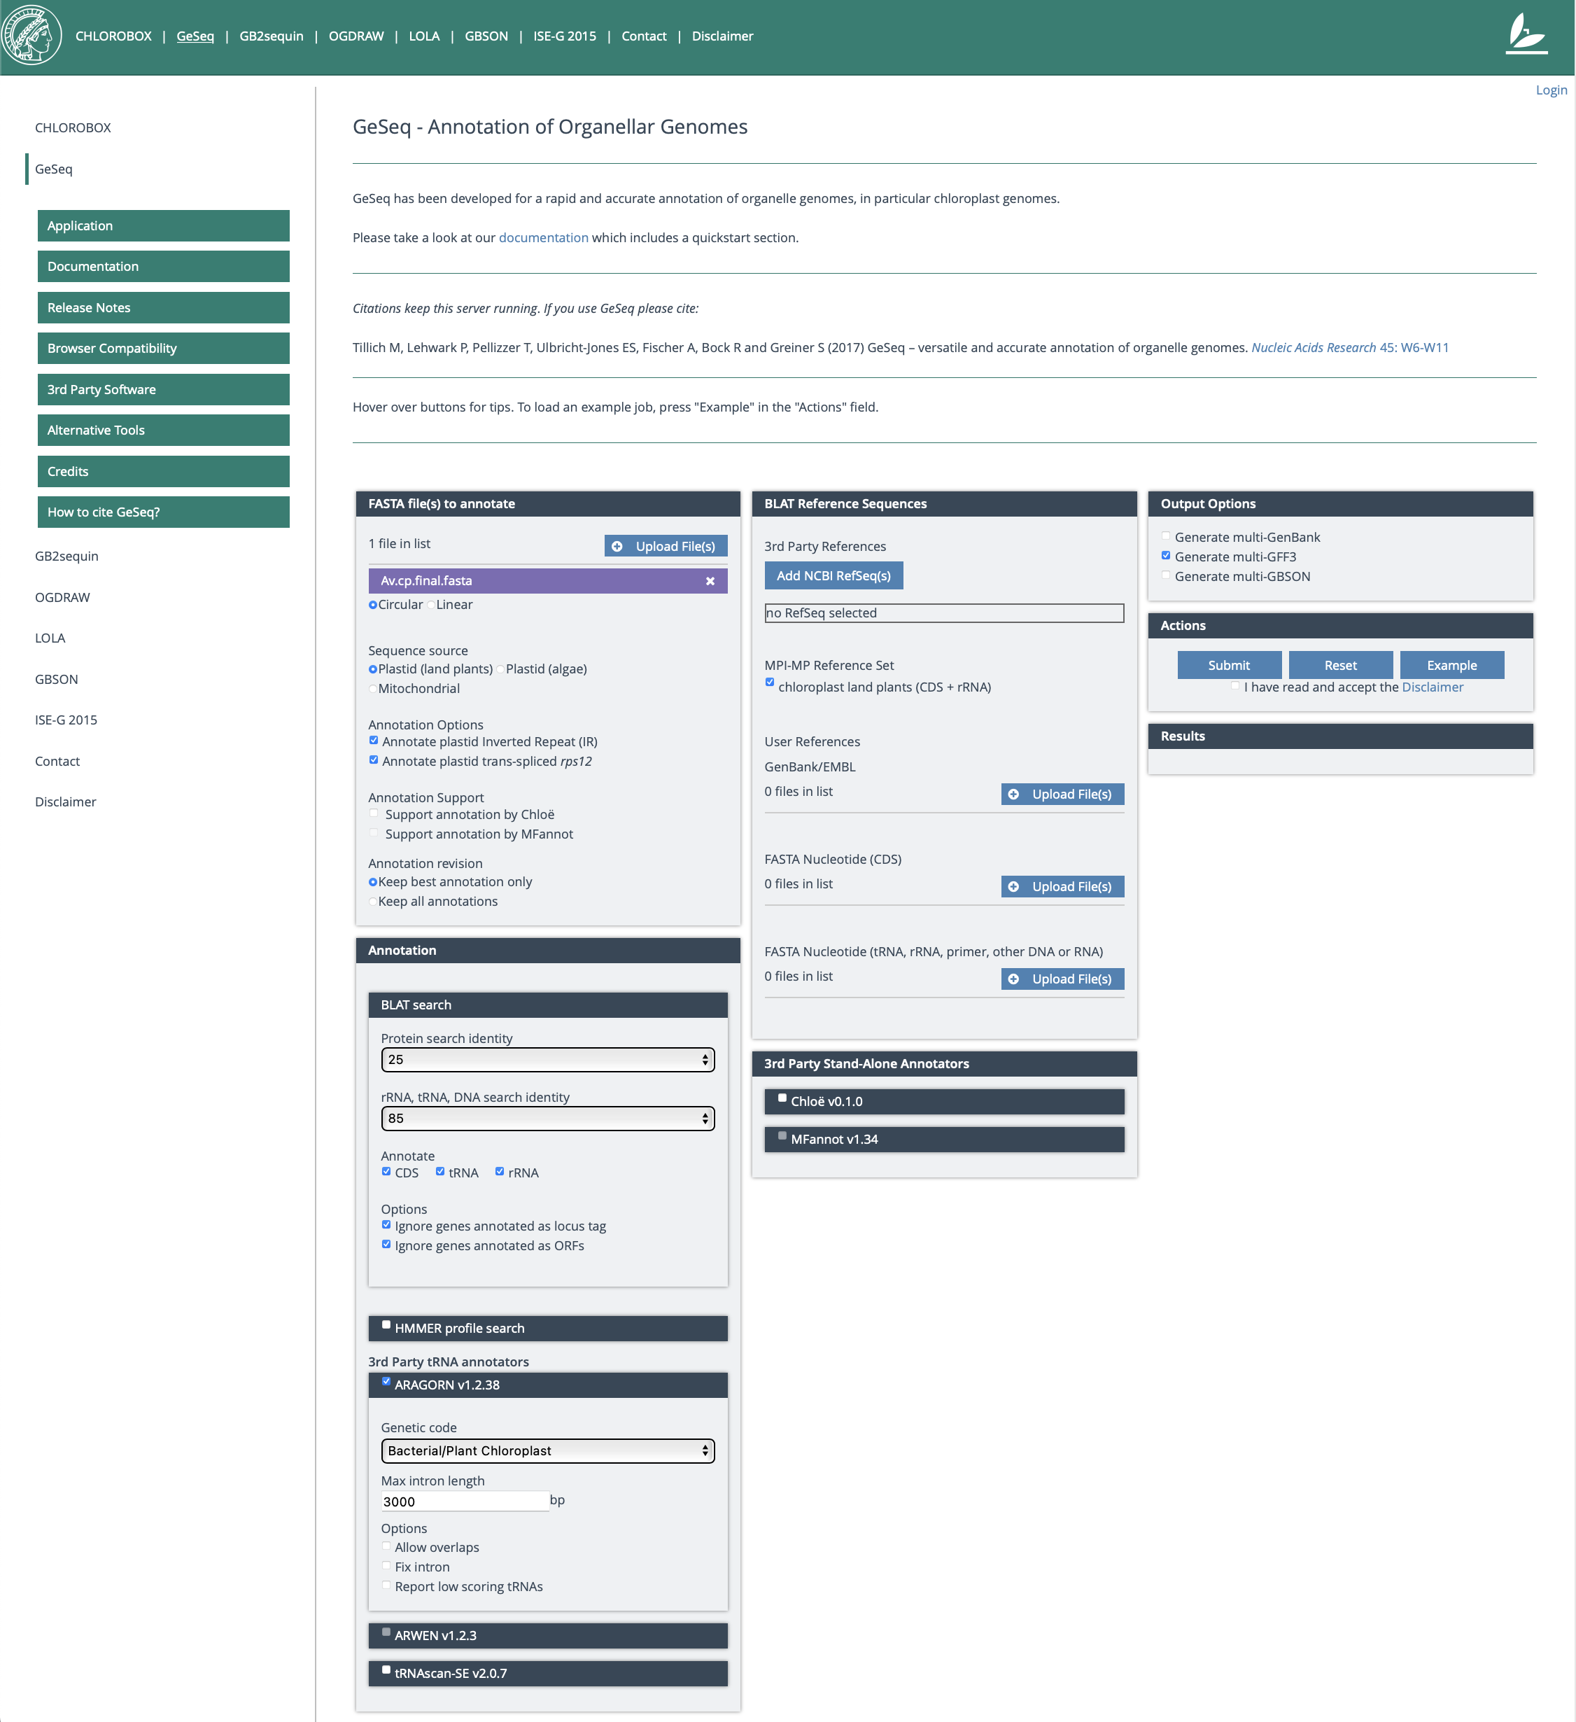

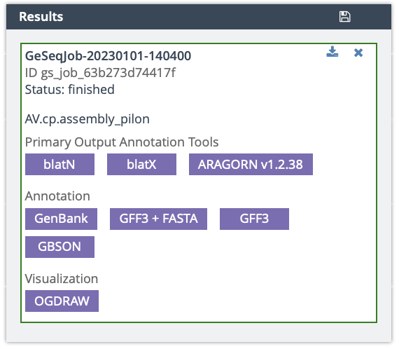
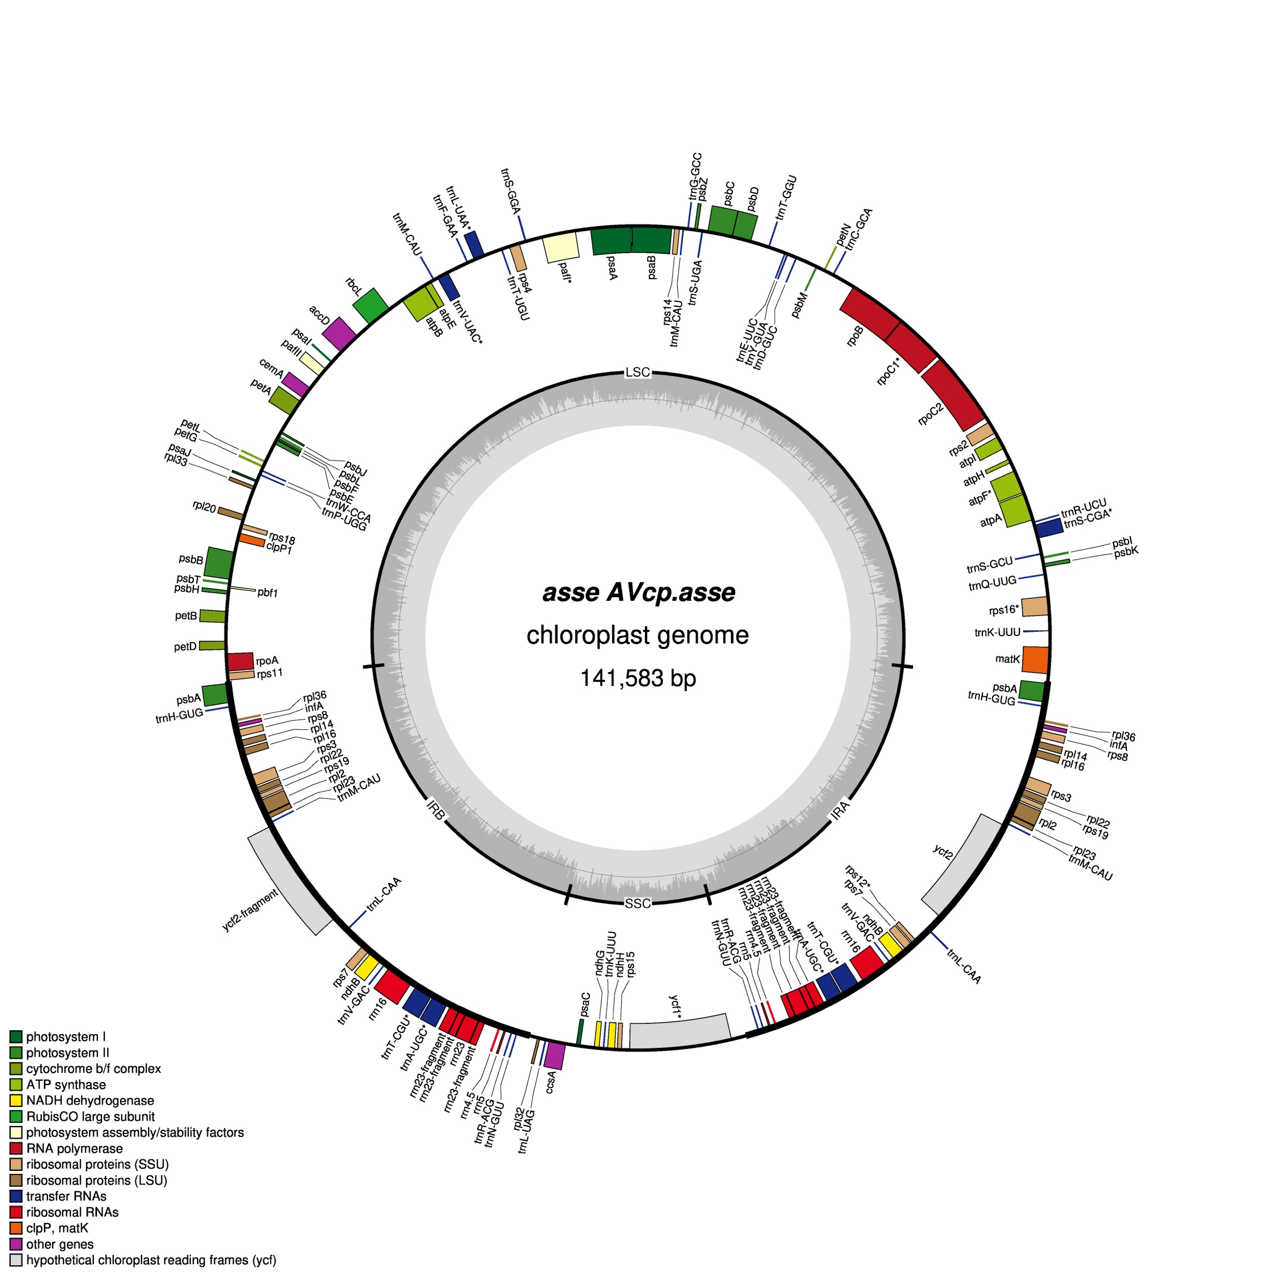
Software used in this Module
GeSeq
https://chlorobox.mpimp-golm.mpg.de/geseq.html
Tillich M, Lehwark P, Pellizzer T, Ulbricht-Jones ES, Fischer A, Bock R and Greiner S (2017)
GeSeq – versatile and accurate annotation of organelle genomes.
Nucleic Acids Research 45: W6-W11
When you use GeSeq in this Module, make sure the settings match those on this slide; the default settings will be different
When GeSeq has finished annotating, the Results panel will look like this:
Click on the GFF3 button to get the annotations in text format
Click on the OGDRAW button to get the annotations as an image

Slide 8
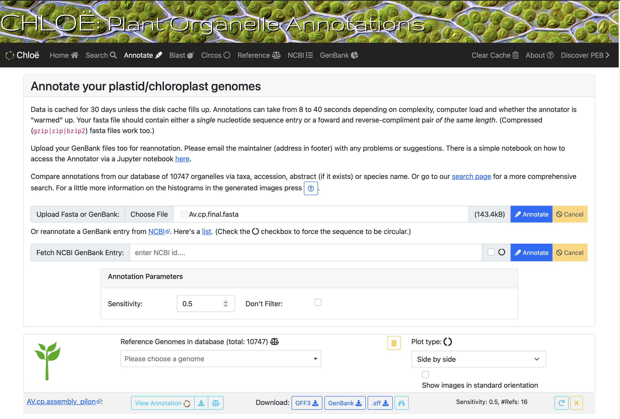
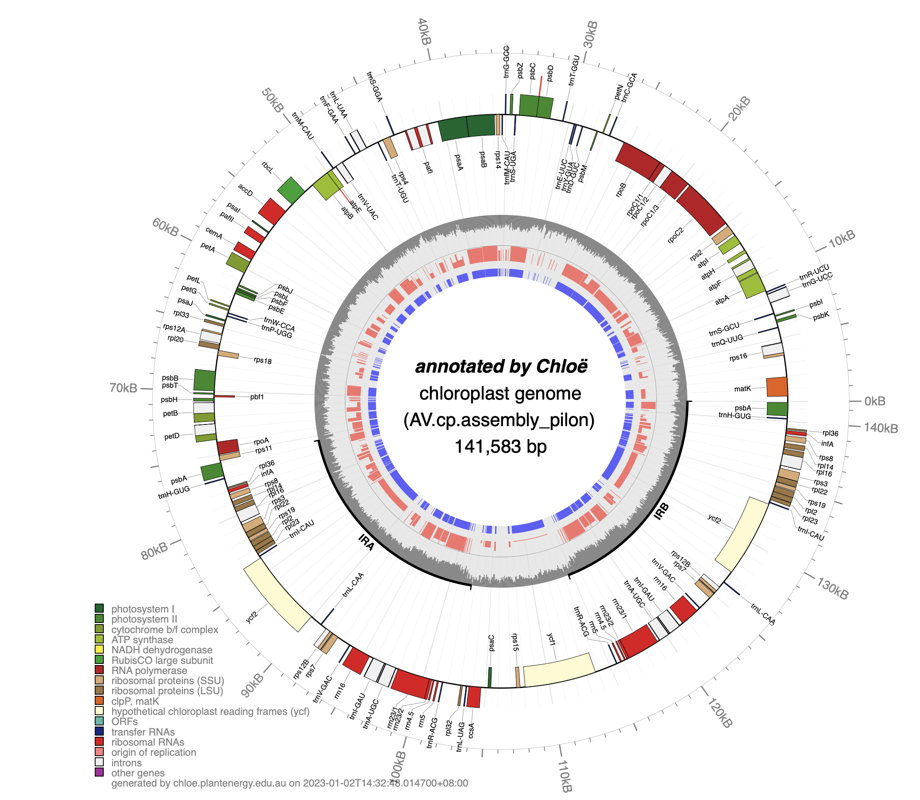
Chloe
https://chloe.plastid.org

Slide 9
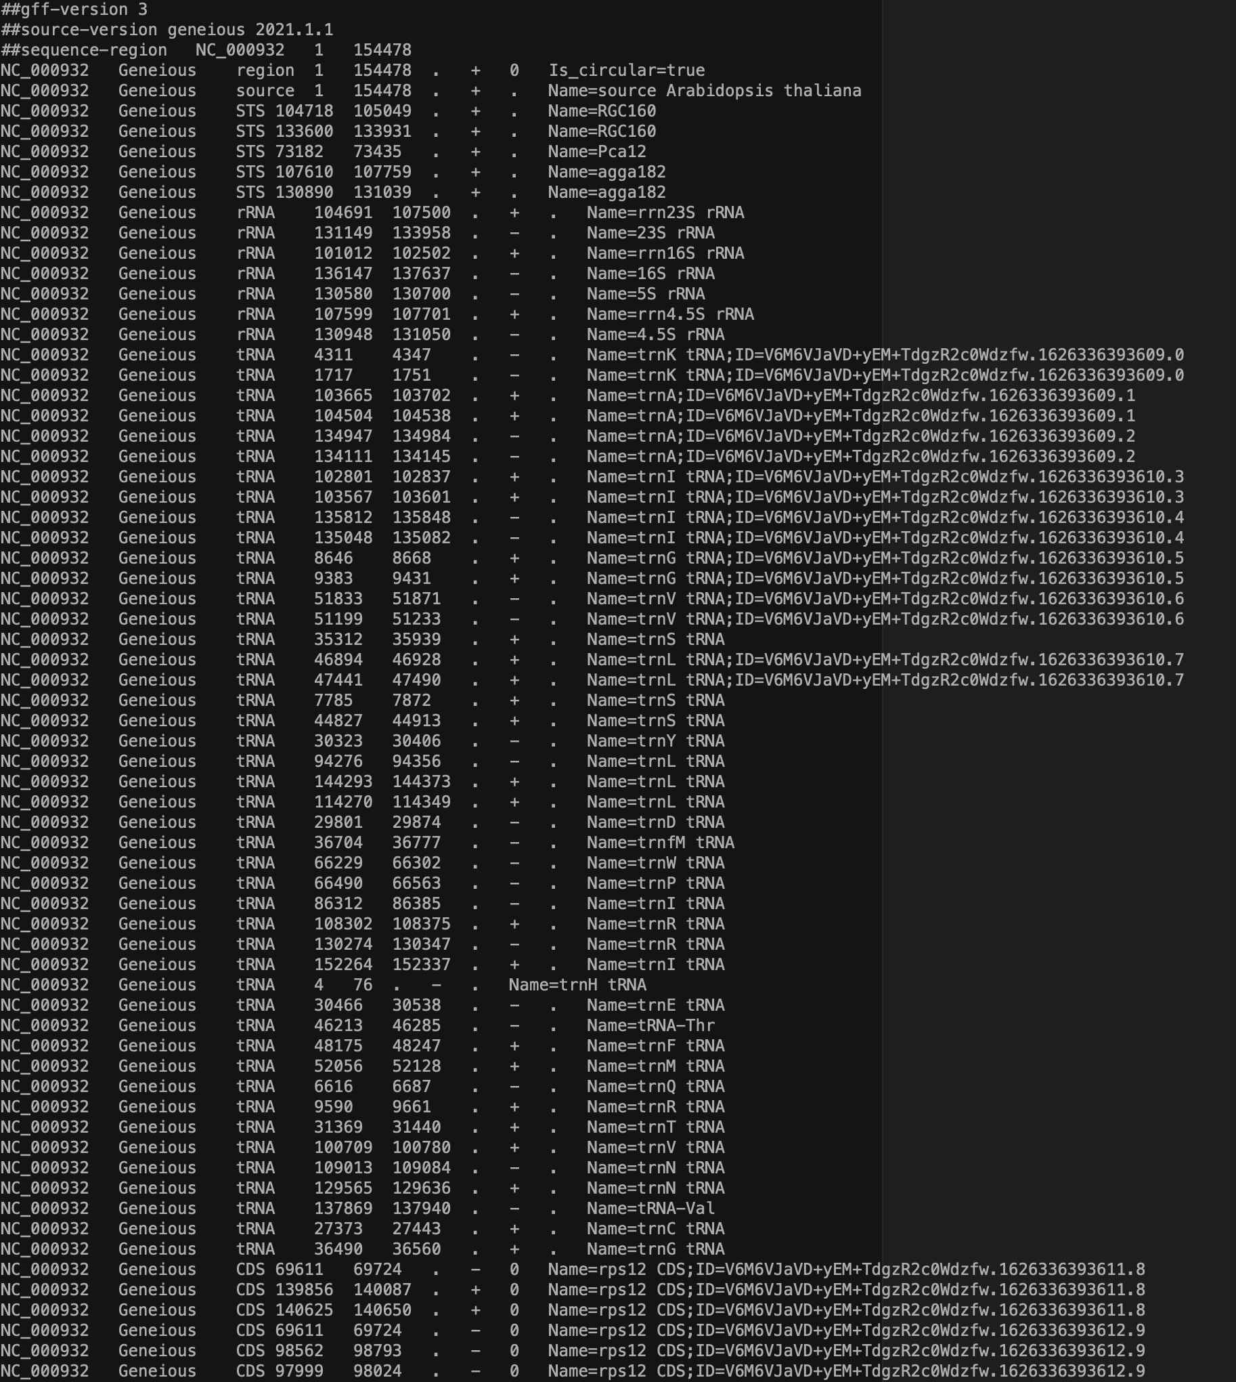
Annotation formats
LOCUS NC_000932 154478 bp DNA circular PLN 31-JUL-2019
DEFINITION Arabidopsis thaliana chloroplast, complete genome.
ACCESSION NC_000932
VERSION NC_000932.1
DBLINK Project: 116
BioProject: PRJNA116
KEYWORDS RefSeq.
SOURCE chloroplast Arabidopsis thaliana (thale cress)
ORGANISM Arabidopsis thaliana
Eukaryota; Viridiplantae; Streptophyta; Embryophyta; Tracheophyta;
Spermatophyta; Magnoliophyta; eudicotyledons; Gunneridae;
Pentapetalae; rosids; malvids; Brassicales; Brassicaceae;
Camelineae; Arabidopsis.
REFERENCE 1 (bases 1 to 154478)
AUTHORS Sato,S., Nakamura,Y., Kaneko,T., Asamizu,E. and Tabata,S.
TITLE Complete structure of the chloroplast genome of Arabidopsis
thaliana
JOURNAL DNA Res. 6 (5), 283-290 (1999)
PUBMED 10574454
REFERENCE 2 (bases 1 to 154478)
CONSRTM NCBI Genome Project
TITLE Direct Submission
JOURNAL Submitted (07-APR-2000) National Center for Biotechnology
Information, NIH, Bethesda, MD 20894, USA
REFERENCE 3 (bases 1 to 154478)
AUTHORS Nakamura,Y.
TITLE Direct Submission
JOURNAL Submitted (09-SEP-1999) Laboratory of Gene Structure 2, Kazusa DNA
Research Institute, Yana 1532-3, Kisarazu, Chiba 292-0812, Japan
COMMENT REVIEWED REFSEQ: This record has been curated by NCBI staff. The
reference sequence was derived from AP000423.
COMPLETENESS: full length.
FEATURES Location/Qualifiers
source 1..154478
/organism="Arabidopsis thaliana"
/organelle="plastid:chloroplast"
/mol_type="genomic DNA"
/db_xref="taxon:3702"
/ecotype="Columbia"
tRNA complement(4..76)
/gene="trnH"
/locus_tag="ArthCt088"
/product="tRNA-His"
/db_xref="GeneID:1466273"
gene complement(4..76)
/gene="trnH"
/locus_tag="ArthCt088"
/db_xref="GeneID:1466273"
CDS complement(383..1444)
/gene="psbA"
/locus_tag="ArthCp002"
/codon_start=1
/transl_table=11
/product="photosystem II protein D1"
/protein_id="NP_051039.1"
/db_xref="GeneID:844802"
/translation="MTAILERRESESLWGRFCNWITSTENRLYIGWFGVLMIPTLLTA
TSVFIIAFIAAPPVDIDGIREPVSGSLLYGNNIISGAIIPTSAAIGLHFYPIWEAASV
DEWLYNGGPYELIVLHFLLGVACYMGREWELSFRLGMRPWIAVAYSAPVAAATAVFLI
YPIGQGSFSDGMPLGISGTFNFMIVFQAEHNILMHPFHMLGVAGVFGGSLFSAMHGSL
VTSSLIRETTENESANEGYRFGQEEETYNIVAAHGYFGRLIFQYASFNNSRSLHFFLA
AWPVVGIWFTALGISTMAFNLNGFNFNQSVVDSQGRVINTWADIINRANLGMEVMHER
NAHNFPLDLAAVEAPSTNG"
GenBank format
GFF3 format

Slide 10
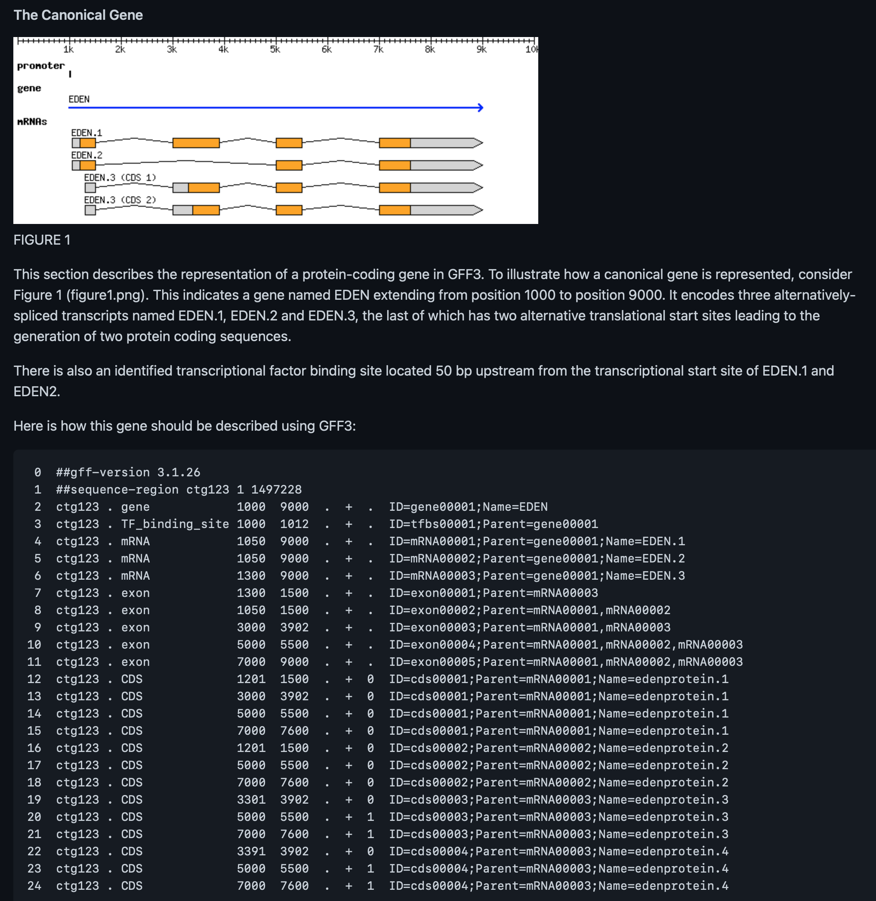
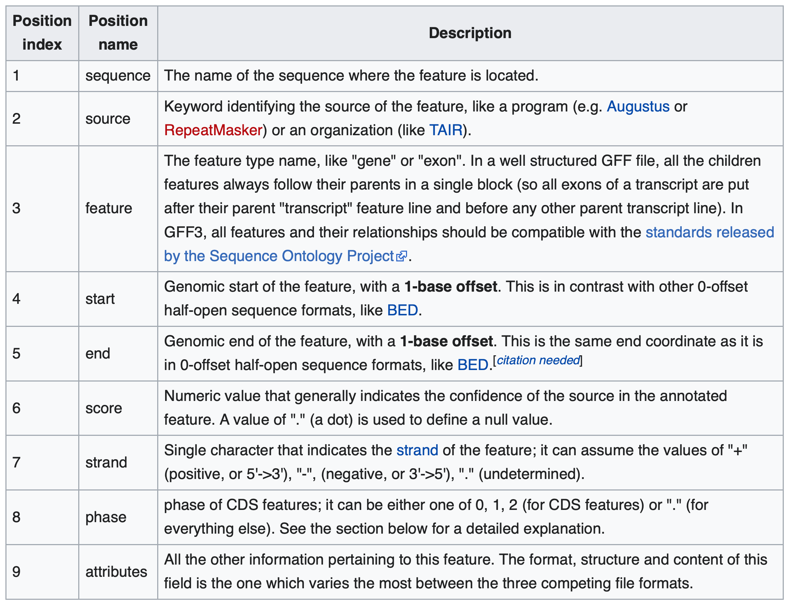
GFF3 format
https://github.com/The-Sequence-Ontology/Specifications/blob/master/gff3.md
https://en.wikipedia.org/wiki/General_feature_format

